Slide 1

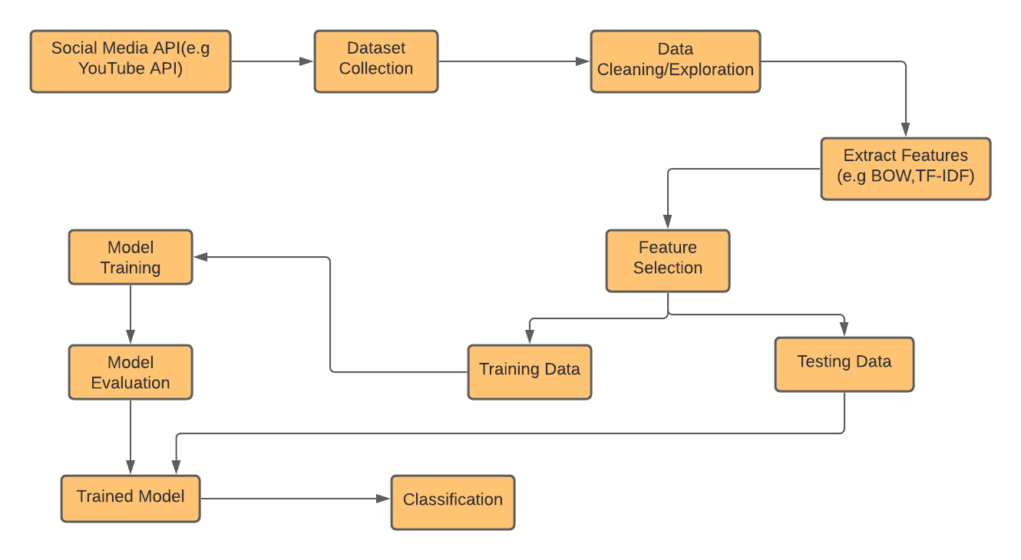
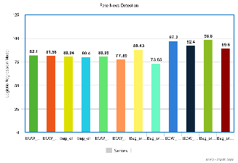
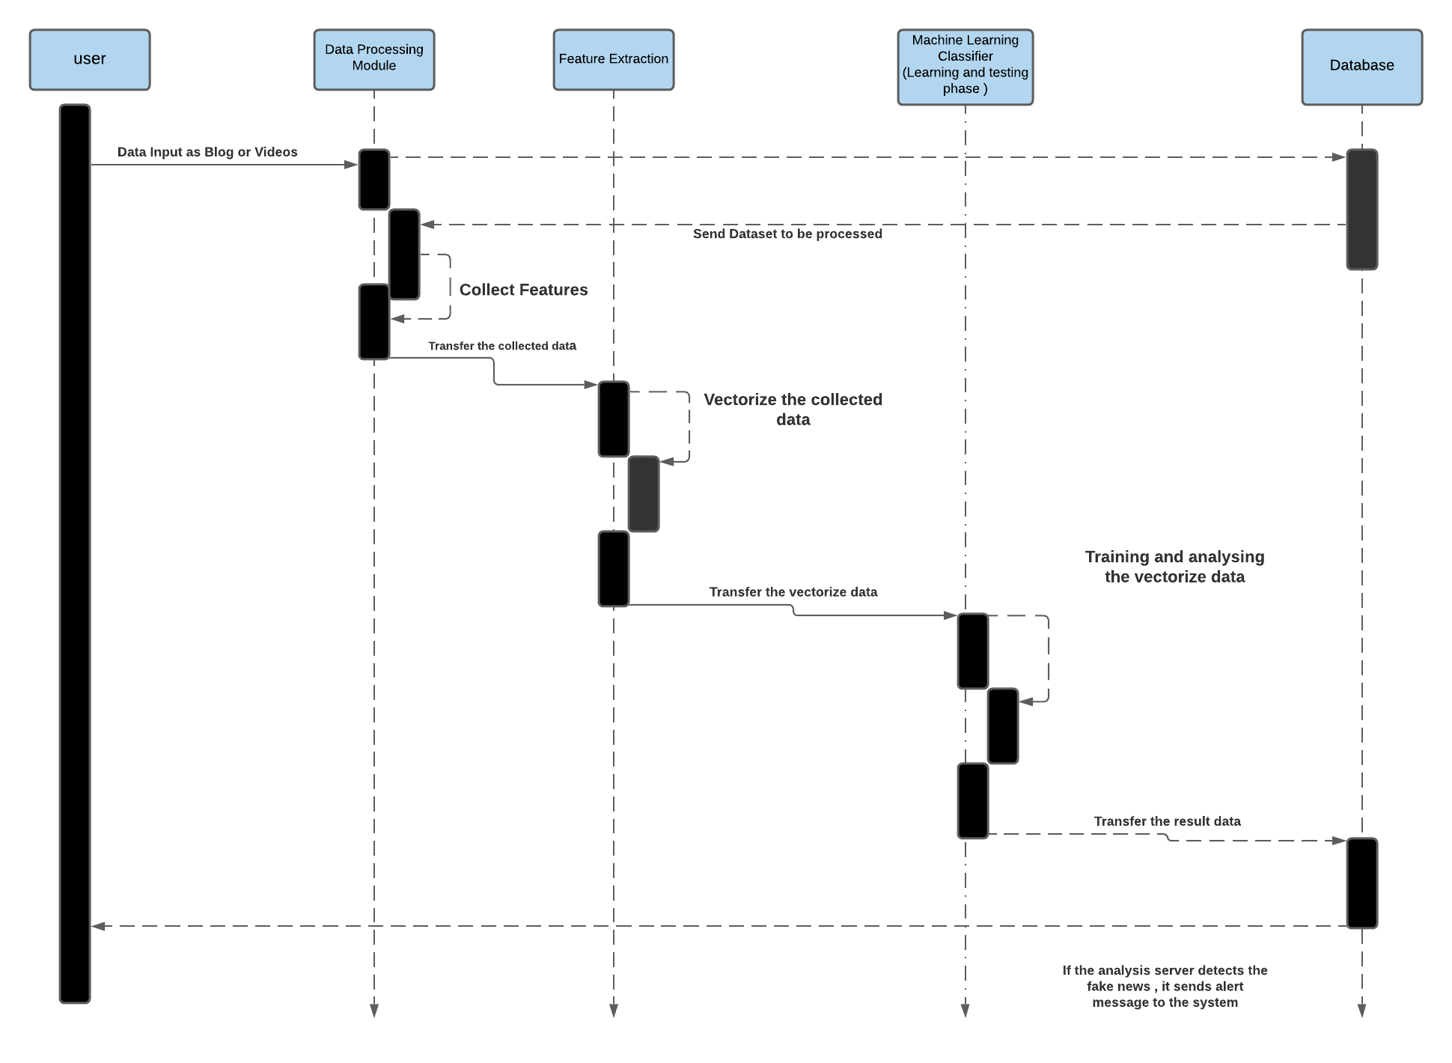

FAKE NEWS DETECTION SYSTEM ON SOCIAL MEDIA PLATFORM MARYAM MUNIR - 180978, QURAT UL AIN - 181030 - BSCS8A SUPERVISOR: SIR SHOAIB MALIK FYP ID :- CS-SP-21-25 BATCH(2018-2022)
Abstract
Results
In this paper, we aim to perform fake news detection on social media platform on academic social media content by using available Checker Dataset for video and text classification with the help of existing Natural Language Processing and Machine Learning techniques. We aim to provide the user with the ability to classify the news as fake or real and also check the authenticity of the scientific content. In this paper, we have used Logistic Regression Model which gives us 82.25% accuracy.
Methodology
The above results are produced after training the model by applying word count based techniques (e.g. bag of words(BOW), bag of ngrams) for feature extraction and Logistic Regression as the machine learning model on the given datasets.
Following three datasets were used in our research:
Fake news detection dataset for text classification.
Checker dataset for videos classification.
Misinformation dataset for videos classification.
Introduction
Fake news detection system not only plays significance role in general social media news but also in academic social media content. Fake news stories are designed to attract readers to spread faster due to which students have to face a lot of difficulties while finding the authentic data related to their work.
Comparison
We have used word count based techniques (e.g. bag of words(BOW), bag of ngram) which will create data features, which are then used as an input to the logistic regression for classifying the news on different datasets i.e Checker Dataset for ClickBait Thumbnail Detection and Misinformation on YouTube Videos for video detection and Fake News Dataset for text classification and got highest results in text classification which gives 97% accuracy and other 2 video datasets gives 82.25% for Checker Dataset and 85% for Misinformation Dataset. We have enhanced 2% accuracy on both of the text and video datasets and got these results.
Fig. 1. Examples of clickbait thumbnails. They are eve-catching at first glance, but the content of the linked videos is inconsistent with what these thumbnails have advertised.
Modules
Firstly, we will remove the unnecessary columns e.g Columns with nan values or containing no text. Only 4 columns were used in each dataset in form of a dataframe which are ID, Title, Text of article/Captions of Videos/Thumbnails text, Labels(fake/real). After the data cleaning and exploration phase, the next step involves extraction of the features. Features were extracted by using different NLP models i.e word count based models(e.g bag of words, and bag of n-grams). The input features are then used to train models. Then dataset is divided into training and testing data to calculate the results.
In our proposed framework, as illustrated below, we are expanding on the current literature by introducing different techniques with various feature sets to classify content from multiple domains as true or fake. There are 2 different modules of our proposed approach:
Video to Text Classification
Text to Text Classification
Following is the Flow diagram of our project:
Conclusions
With the help of Machine Learning, we are done with the single module of this system by using word count based models(e.g. bag of words(BOW), bag of ngram) .This project can be further enhanced to provide greater flexibility and performance with certain modification whenever necessary such as deep fake learning.

